Slide 1
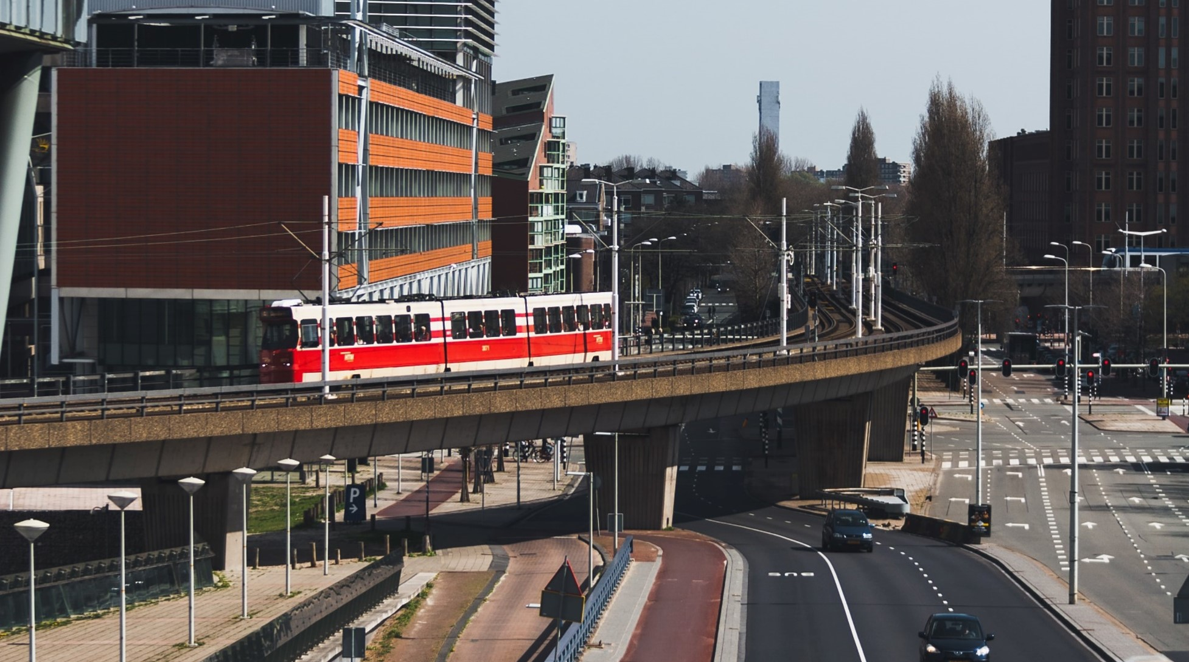

GLOBAL INFRASTRUCTURE INDEX 2021
In partnership with:

Slide 2
Infrastructure: more are satisfied than not, but many are on the fence
Dissatisfied
Satisfied
Q. We now want you to think about [COUNTRY’S] infrastructure.
By infrastructure we mean things we rely on like road, rail and air networks, utilities such as energy and water, and broadband and other communications.
Overall, how satisfied or dissatisfied are you with [COUNTRY’S] national infrastructure?
27%
39%
Very satisfied
Fairly satisfied
Neither/nor
Fairly dissatisfied
Very dissatisfied
Don’t know
The Global Country Average reflects the average result for all the countries where the survey was conducted. It has not been adjusted to the population size of each country and is not intended to suggest a total result.
GLOBAL COUNTRY
AVERAGE
Source: Ipsos/GIIA
Base: 19,514 adults (online), July-August 2021

Slide 3
There is considerable variation in satisfaction levels across the 28 countries
Q. We now want you to think about [COUNTRY’S] infrastructure.
By infrastructure we mean things we rely on like road, rail and air networks, utilities such as energy and water, and broadband and other communications.
Overall, how satisfied or dissatisfied are you with [COUNTRY’S] national infrastructure?
% very/fairly satisfied
Online samples in Brazil, China, Chile, Colombia, India, Malaysia, Mexico, Peru, Russia, Saudi Arabia, South Africa, and Turkey tend to be more urban, educated, and/or affluent than the general population.
Source: Ipsos/GIIA
Base: 19,514 adults (online), July-August 2021

Slide 4
Satisfaction is relatively low in n. America and LATAM
Q. We now want you to think about [COUNTRY’S] infrastructure.
By infrastructure we mean things we rely on like road, rail and air networks, utilities such as energy and water, and broadband and other communications.
Overall, how satisfied or dissatisfied are you with [COUNTRY’S] national infrastructure?
All figures are %s
Very/fairly satisfied
Very/fairly dissatisfied
Global Country Average
G8
See slide 18 for note on regional classifications. The Global Country Average reflects the average result for all the countries where the survey was conducted.
Source: Ipsos/GIIA
Base: 19,514 adults (online), July-August 2021

Slide 5
Longer-term trends: satisfaction dipped in 2018 but bounced back
Q. We now want you to think about [COUNTRY’S] infrastructure.
By infrastructure we mean things we rely on like road, rail and air networks, utilities such as energy and water, and broadband and other communications.
Overall, how satisfied or dissatisfied are you with [COUNTRY’S] national infrastructure?
% very/fairly satisfied
G8
Global Country Average
Europe
The Global Country Average reflects the average result for all the countries where the survey was conducted. It has not been adjusted to the population size of each country and is not intended to suggest a total result. The 2016-2020 surveys used the same methodology, but the profile of participating countries changed. This means that the global country average/trend does not always involve a completely like-for-like comparison.
Source: Ipsos/GIIA
Base: 19,514 adults (online), July-August 2021

Slide 6
Infrastructure continues to be an area where the public feel more can be done…
Q. To what extent do you agree or disagree…“As a country we are not doing enough to meet our infrastructure needs”
Global Country Average
Agree
Disagree
Source: Ipsos/GIIA
Base: 19,514 adults (online), July-August 2021

Slide 7
A majority in most countries agree ‘not enough is being done’
Q. Still thinking about infrastructure – the things we rely on like road, rail and air networks, utilities such as energy and water, and broadband and other communications – to what extent do you agree or disagree…?
“As a country we are not doing enough to meet our infrastructure needs”
% strongly/tend to agree
Online samples in Brazil, China, Chile, Colombia, India, Malaysia, Mexico, Peru, Russia, Saudi Arabia, South Africa, and Turkey tend to be more urban, educated, and/or affluent than the general population.
Source: Ipsos/GIIA
Base: 1,000 GB adults among 19,514 (online), July-August 2021

Slide 8
as last year, it is felt that investment will create jobs and provide an economic boost
Q. Still thinking about infrastructure – the things we rely on like road, rail and air networks, utilities such as energy and water, and broadband and other communications – to what extent do you agree or disagree…?
“Investing in infrastructure will create new jobs and boost the economy”
% strongly/tend to agree
Online samples in Brazil, China, Chile, Colombia, India, Malaysia, Mexico, Peru, Russia, Saudi Arabia, South Africa, and Turkey tend to be more urban, educated, and/or affluent than the general population.
Source: Ipsos/GIIA
Base: 1,000 GB adults among 19,514 (online), July-August 2021

Slide 9
It’s still the case that a clear majority are comfortable with private sector investment
Q. Still thinking about infrastructure – the things we rely on like road, rail and air networks, utilities such as energy and water, and broadband and other communications – to what extent do you agree or disagree…?
“I’m fine with businesses in the private sector investing money in infrastructure if it means [COUNTRY] gets the infrastructure it needs”
Global Country Average
Disagree
Disagree
8%
10%
Strongly agree
Tend to agree
Neither/nor
Tend to disagree
Agree
Strongly disagree
Agree
Don’t know
67%
63%
2020
2021
Source: Ipsos/GIIA
Base: 1,000 GB adults among 19,514 (online), July-August 2021

Slide 10
PRIORITIES and preferences

Slide 11
As before, there is strong competition for the top investment priorities
Q. Which of these types of infrastructure, if any, do you think should be made a priority for investment for…
[COUNTRY]?
% selecting
Global Country Average
N.B. Nuclear not asked in Australia, Chile, Italy, Malaysia, Peru, Poland, Saudi Arabia, Turkey - % shown based on all countries where asked
Source: Ipsos/GIIA
Base: 19,514 adults (online), July-August 2021

Slide 12
Plurality preference for social vs economic infrastructure but this has weakened
Statement A: “We should give highest priority to improving [COUNTRY]’s economic infrastructure such as road, rail and air networks, utilities such as energy and water, and broadband and other communications.”
Statement B: “We should give highest priority to improving [COUNTRY]’s social infrastructure such as school and hospital buildings, and housing.”
% strongly/tend to prefer
each statement
Global Country Average
Source: Ipsos/GIIA
Base: 1,000 GB adults among 19,514 (online), July-August 2021

Slide 13
Continued preference to maintain/repair rather than build new
Statement A: “We should prioritise maintaining and repairing existing infrastructure in [COUNTRY] before spending on new infrastructure.”
Statement B: “We need to spend money on new infrastructure in [COUNTRY] even if it means having less to spend less on maintaining and repairing existing infrastructure.”
% strongly/tend to prefer
each statement
Global Country Average
Source: Ipsos/GIIA
Base: 1,000 GB adults among 19,514 (online), July-August 2021

Slide 14
People prioritise considering environmental impacts over economic ones
Statement A: “When making decisions about how to improve infrastructure in [COUNTRY], we should give higher priority to the impact it has on the environment.”
Statement B: ““When making decisions about how to invest in infrastructure in [COUNTRY], we should give higher priority to the impact it has on the economy.”
Global Country Average
Source: Ipsos/GIIA
Base: 1,000 GB adults among 19,514 (online), July-August 2021

Slide 15
The environment AND QUALITY ARE top prioritIES
Factor
Disruption: the amount of disruption we have to deal with (e.g. roadworks, disruptions to water supply) while infrastructure is built or improved
Legacy: the infrastructure that we pass on to future generations
Resilience: how well our infrastructure stands up to challenges today and in the future (e.g. population increases and climate change)
Environment: the impact our infrastructure has on our environment
Investment: paying for the costs of improving and building new infrastructure now, to avoid having to pay more later
Quality: making sure that infrastructure is as good as it possibly can be (e.g. in terms of speed or convenience of services)
Ownership: whether the infrastructure is owned by the public sector – that is, national or local government or some other public sector body – or private businesses
Q. Which of the following factors do you think are the most important for [COUNTRY] to consider when putting together plans for infrastructure in the future? Please rank the following…
% ranking factor as most important
(1st out of 7)
All % figures shown are Global Country Average
Global Country Average
9
7
9
23
13
13
26
Source: Ipsos/GIIA
Base: 1,000 GB adults among 19,514 (online), July-August 2021

Slide 16
Ownership, disruption and legacy are relatively low priorities
Factor
Disruption: the amount of disruption we have to deal with (e.g. roadworks, disruptions to water supply) while infrastructure is built or improved
Legacy: the infrastructure that we pass on to future generations
Resilience: how well our infrastructure stands up to challenges today and in the future (e.g. population increases and climate change)
Environment: the impact our infrastructure has on our environment
Investment: paying for the costs of improving and building new infrastructure now, to avoid having to pay more later
Quality: making sure that infrastructure is as good as it possibly can be (e.g. in terms of speed or convenience of services)
Ownership: whether the infrastructure is owned by the public sector – that is, national or local government or some other public sector body – or private businesses
Q. Which of the following factors do you think are the most important for [COUNTRY] to consider when putting together plans for infrastructure in the future? Please rank the following…
% ranking factor as most important
(7th out of 7)
All % figures shown are Global Country Average
Global Country Average
20
24
21
6
9
10
10
Source: Ipsos/GIIA
Base: 1,000 GB adults among 19,514 (online), July-August 2021

Slide 17
TECHNICAL DETAILS

Slide 18
METHODOLOGY
2021: 28 countries, 19,514 participants, 23 July–6 August 2021 (online):
Argentina, Australia*, Belgium, Brazil*, Canada*, Chile, China*, Colombia, France*, Germany*, Great Britain*, Hungary, India, Italy*, Japan*, Malaysia, Mexico, Netherlands, Peru, Poland, Russia, Saudi Arabia, South Africa, South Korea, Spain*, Sweden, Turkey and the United States of America* * denotes 1,000+ sample size
The samples in Brazil, China, Chile, Colombia, India, Malaysia, Mexico, Peru, Russia, Saudi Arabia, South Africa and Turkey are more urban, more educated and/or more affluent than the general population. Results should be viewed as reflecting the views of the more “connected” segment of their population.
Participants were adults aged 18-64 in the US and Canada, and adults aged 16-64 in all other countries.
Results may not sum to 100% and combinations to their constituent %s (e.g. very/fairly satisfied) due to computer rounding.
The 2016-2020 surveys used the same methodology, but the profile of participating countries changed. This means that the global country average/trend does not always involve a completely like-for-like comparison. Details are available:
https://www.ipsos.com/ipsos-mori/en-uk/survey-shows-strong-public-backing-investment-infrastructure-aid-recovery (2020) - 27 countries
https://www.ipsos.com/en/global-infrastructure-index-public-satisfaction-and-priorities-2019 (2019) - 28 countries
https://www.ipsos.com/en/global-infrastructure-index-public-satisfaction-and-priorities-2018 (2018) - 29 countries
https://www.ipsos.com/ipsos-mori/en-uk/rail-joins-housing-top-infrastructure-priorities-britons (2017) - 28 countries
https://www.ipsos.com/ipsos-mori/en-uk/do-more-poll-shows-britons-behind-action-infrastructure (2016) - 26 countries

Slide 19
Online survey, 28 countries,
23 July-6 August
N.B. the 2016-21 surveys used the same methodology, but the profile of participating countries changed between years. This means that the global and regional trends do not always involve a strict like-for-like comparison. Participants were adults aged 18-74 in Canada, Malaysia, South Africa, Turkey, and the U.S., 16-74 elsewhere.
Europe
Belgium
France
Germany
Great Britain
Hungary
Italy
Netherlands
Poland
Spain
Sweden
7,502
N. America
LATAM
APAC
G8
BRIC
ME Africa
Canada
U.S.A.
Argentina
Brazil
Chile
Colombia
Mexico
Peru
Australia
China
India
Japan
Malaysia
South Korea
Canada
France
Germany
Great Britain
Italy
Japan
Russia
U.S.A.
Brazil
Russia
India
China
Saudi Arabia
South Africa
Turkey
2,002
3,503
4,506
7,504
3,005
1,501
Source: Ipsos/GIIA
Base: 19,514 adults (online), July-August 20201

Slide 20

FURTHER INFORMATION
Ben.Marshall@ipsos.com
Adam.Hanrahan@ipsos.com
THoran@giia.net
JPhillips@giia.net

